Slide 1
Subjective and Objective Measures of Well-being

Slide 2
In the objective approach the focus is on measuring ‘hard’ facts, such as income in dollars or living accommodation in square metres.
The subjective approach, in contrast, considers ‘soft’ matters, such as satisfaction with income and perceived adequacy of dwellings.

Slide 3
Two dimensions of difference
1- SUBSTANCE
There is a difference in the substance of the matter measured. Objective indicators are concerned with things that exist independent of subjective awareness. For instance: someone can be ill in an objective sense, because a tumour is spreading in the body, without that person knowing.

Slide 4
2- ASSESSMENT
Objective measurement is based on explicit criteria and performed by external observers. Illness can be measured objectively by the determining presence of antigens in the blood (Given these operational definitions, any impartial observer will come to the same conclusion).
Subjective measurement involves self-reports based on implicit criteria. When we say we feel sick, we mostly cannot explain in much detail why we feel so and someone else, with the same symptoms, may be less apt to define himself as unwell.

Slide 5
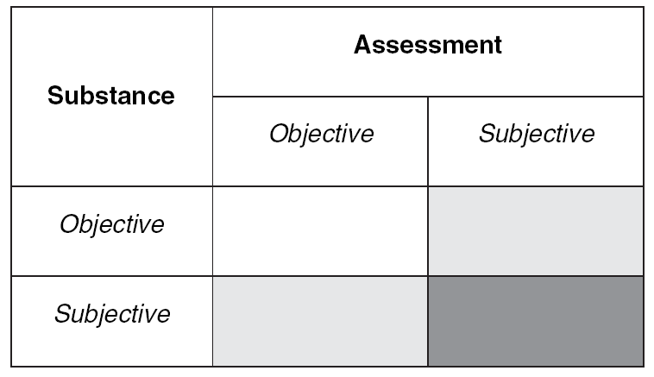
actual ‘wealth’ of a person when measured
by her bank account.
Measuring wealth using self-perceived wealthiness
measuring happiness using self-report
measuring happiness by relating it to the use of anti-depressants
Objective–subjective difference: basic configurations

Slide 6
Type 1 Illness revealed by symptoms such as weight loss or biochemical tests;
Type 2 Illness diagnosed by a doctor on the basis of a patient’s complaints;
Type 3 Perception of being ill by one-self (possibly without feeling sick);
Type 4 Being and feeling ill as apparent in sickness behaviours such as absenteeism and visiting the doctor;
Type 5 Being and feeling ill measured by a health questionnaire that involves both perceptions of functional health and health complaints;
Type 6 Being and feeling ill as reported directly by a person;
Type 7 Feeling ill as apparent by consumption of relief drugs, such as painkillers or tranquilizers;
Type 8 Feeling ill measured using a sickness complaint inventory;
Type 9 Feeling ill measured using a response to a single question on how fit or sick one feels.

Slide 7
Measuring the Subjective Well- Being of Nations
Alternative way of measuring society’s wellbeing, based on time use and affective (emotional) experience National Time Accounting (NTA).
National Time Accounting is a set of methods for measuring, categorizing, comparing, and analyzing the way people spend their time, across countries, over historical time, or between groups of people within a country at a given time.

Slide 8
Perhaps related to the outpouring of research into subjective well- being, policymakers and statistical agencies around the world have shown increased interest in measuring subjective well- being as part of their national statistics.
National Time Accounting provides a method for tracking time allocation and assessing whether people are experiencing their daily lives in more or less enjoyable ways.

Slide 9
Most past efforts to evaluate time use rely on researchers’ external judgments regarding which activities constitute enjoyable leisure and which constitute arduous work and home production.
NTA relies on individuals’ own evaluations of their emotional experiences during their arious uses of time.

Slide 10
Widely used measures from the National Income Accounts (NIA), such as gross domestic product (GDP) per capita and consumption per capita, only represent a component of total welfare .
Well- being depends on more than economic output and material consumption.
In addition, aspects of life that contribute to economic output may detract from well- being. For example, an increase in pollution could be associated with decreased welfare but increased production and national income.

Slide 11
Thus, the circle representing NIA partly falls outside the box representing total welfare.
National Time Accounting partly overlaps with NIA, but also reflects other features of well- being that are not captured by NIA. For example, time spent socializing with friends is not measured in national income but is important for well- being.

Slide 12
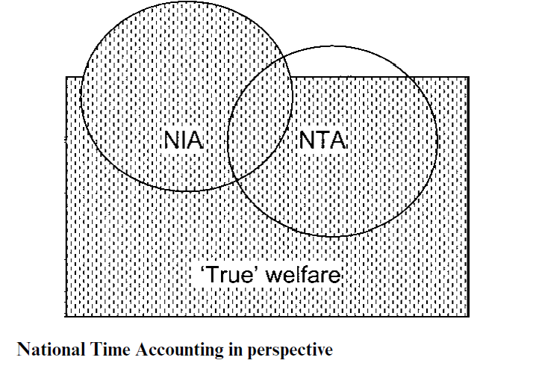
A society’s well- being or “true welfare” is represented by the rectangle.

Slide 13
Two challenges for Measuring the Subjective Well- Being:
The scale of measurement is unclear.
Different people are likely to interpret the same scale differently.

Slide 14
The U- index measures the proportion of time an individual spends in an unpleasant state.
The U- index is an ordinal measure at the level of feelings.
The first step in computing the U- index is to determine whether an episode is unpleasant or pleasant. There are many possible ways to classify an episode as unpleasant or pleasant.

Slide 15
The data collected with Experience Sampling Methods (ESM) or the Day Reconstruction Method (DRM) include descriptions of an individual’s emotional state during each episode in terms of intensity ratings on several dimensions of feelings, some of which are positive (e.g., “Happy,” “Enjoy myself,” “Friendly”) and some of which are negative (e.g., “Depressed,” “Angry,” “Frustrated”).

Slide 16
First, classify an episode as unpleasant if the most intense feeling reported for that episode is a negative one—that is, if the maximum rating on any of the negative affect dimensions is strictly greater than the maximum of rating of the positive affect dimensions (this definition relies purely on an ordinal ranking of the feelings)

Slide 17
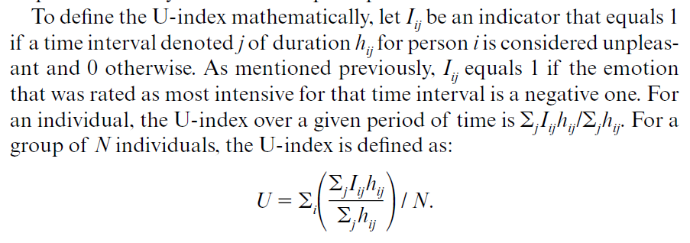

Slide 18
The group U- index can be interpreted as the average proportion of time that members of the group spend in an unpleasant state.

Slide 19
Most people would prefer to be married to a partner who is happy and satisfi ed rather than depressed and dissatisfi ed. Consistent with this preference, several longitudinal studies show that people who report in sample surveys that they are happy.

Slide 20
The Experience Sampling Method (ESM) and Ecological Momentary Assessment (EMA) were developed to collect information on people’s reported feelings in real time in natural settings during selected moments of the day

Slide 21
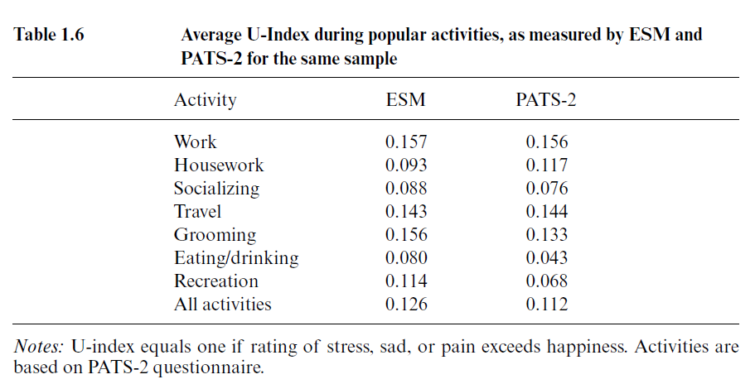

Slide 22
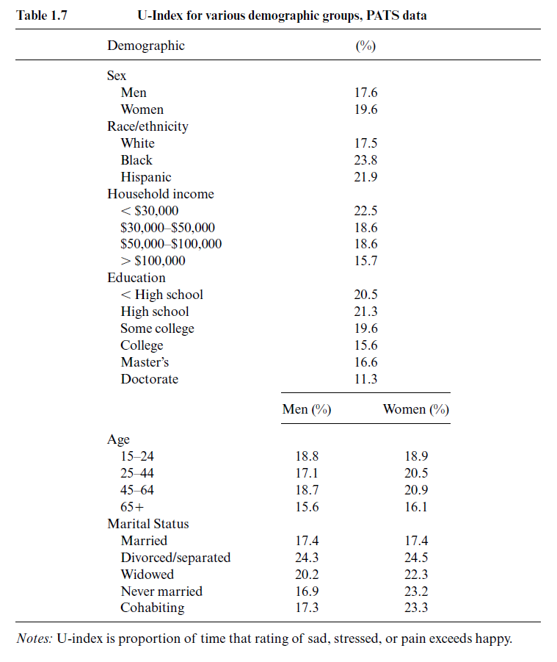

Slide 23
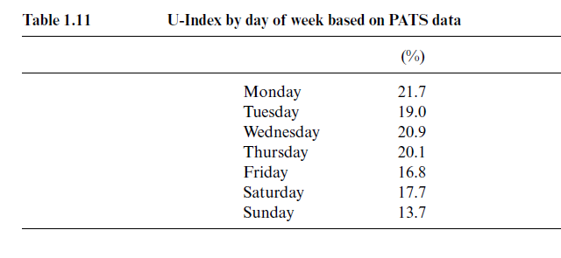

Slide 24
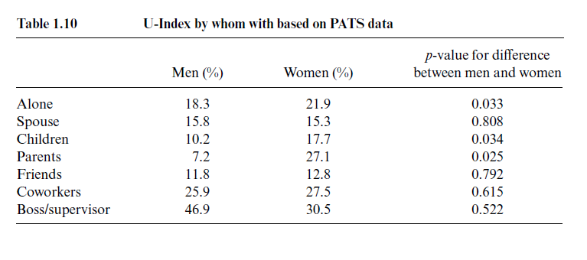

Slide 25
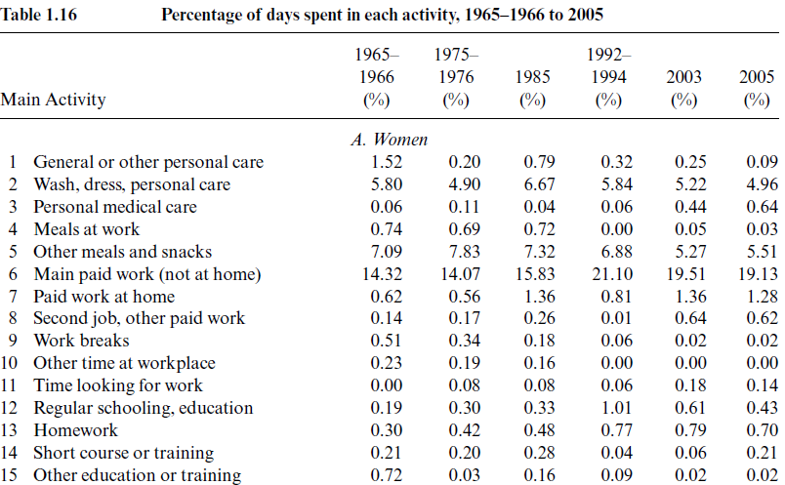

Slide 26
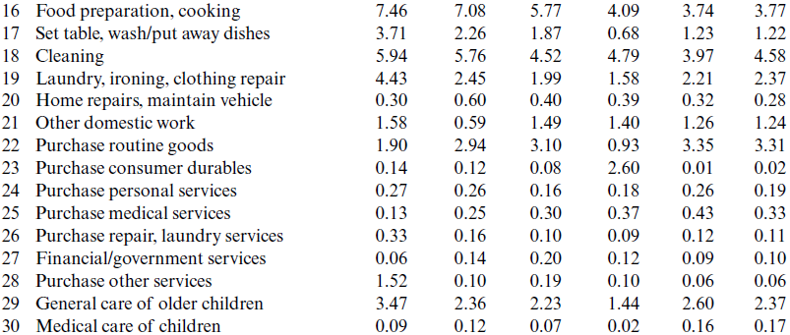

Slide 27
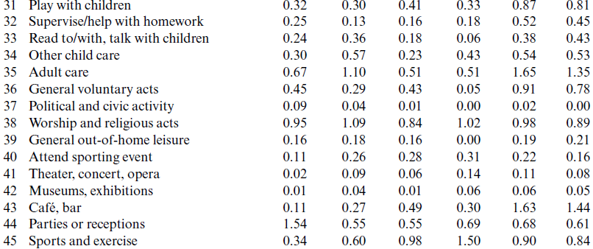

Slide 28
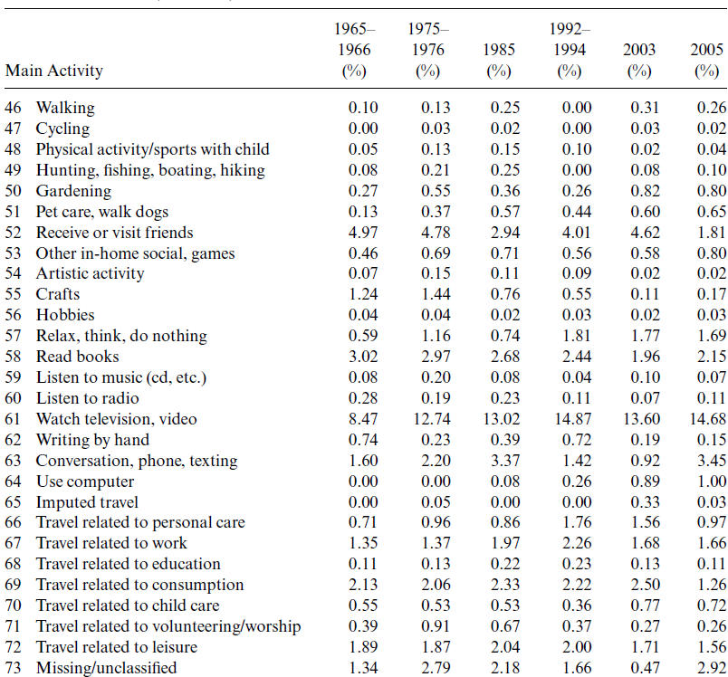

Slide 29
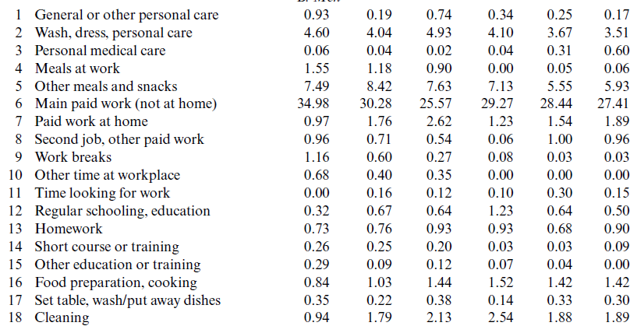

Slide 30
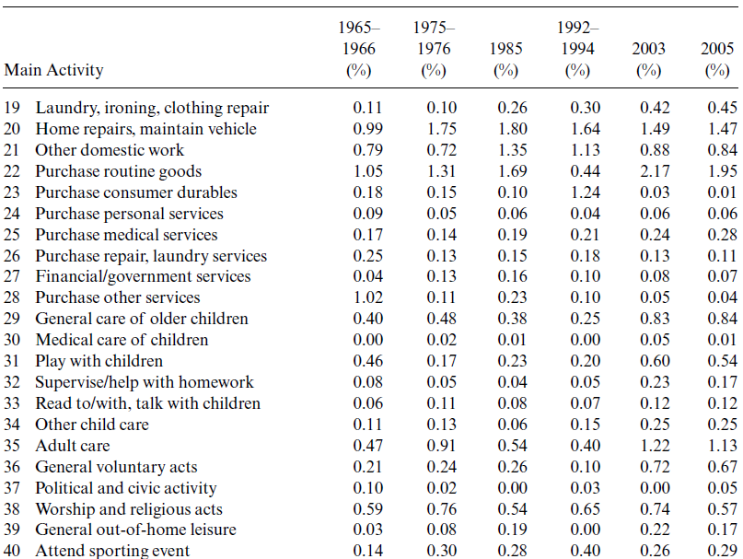

Slide 31
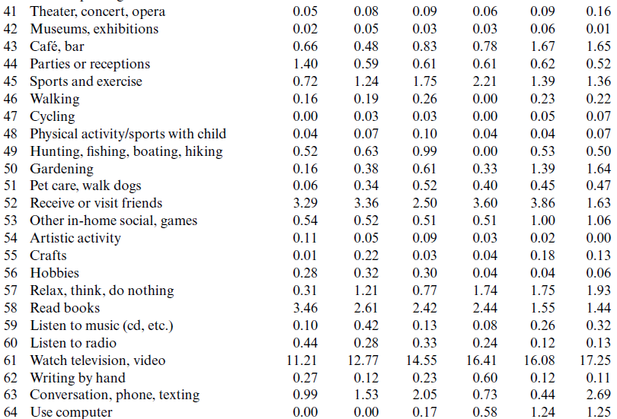

Slide 32
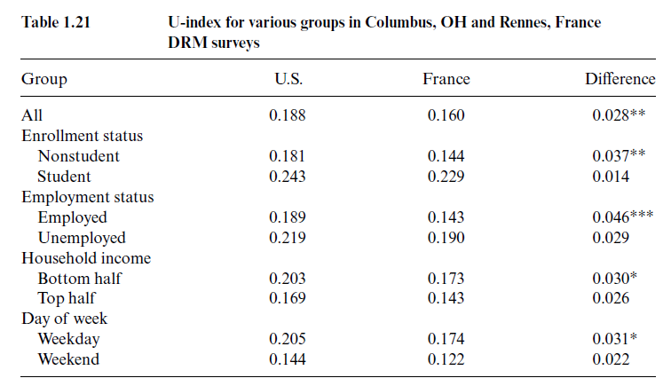

Slide 33
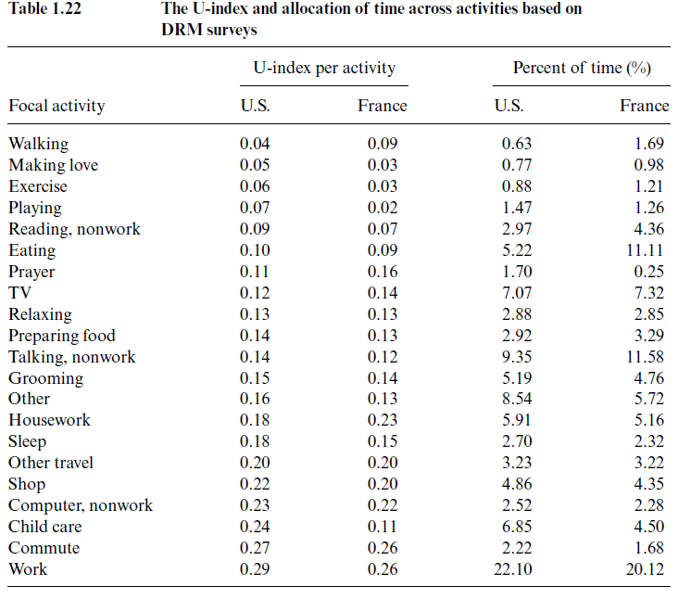

Slide 34
Emphasize that subjective- well being is multidimensional.
At the individual level within a country, the demographic correlates of experi- enced well- being and life (or happiness) satisfaction mostly have the same sign.
Life satisfaction and the U- index, however, yield a different ranking of France and the United States, most likely because of cultural differences in reporting that lead the French to appear less satisfied.

Slide 35
Differences in subjective well- being between age groups can be attributed to a component due to differences in time allocation and a component due to differences in feelings for a given set of activities. This analysis revealed that differences in time use account for a majority of the difference in experienced well- being between younger and older individuals.

Slide 36
NTA is a descriptive, not prescriptive, technique. The method of NTA does not lead to immediate policy recommendations. For example, the fact that spending time socializing may be more enjoyable than working for pay for the average person does not necessarily lead to the recommendation that people should socialize more and work less.

Slide 37
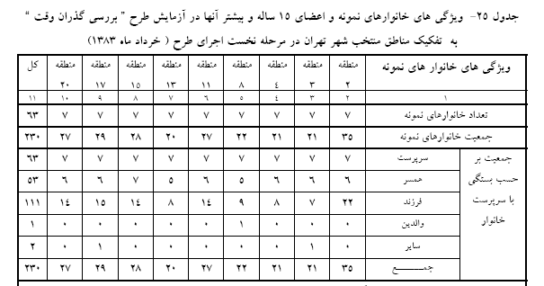

Slide 38
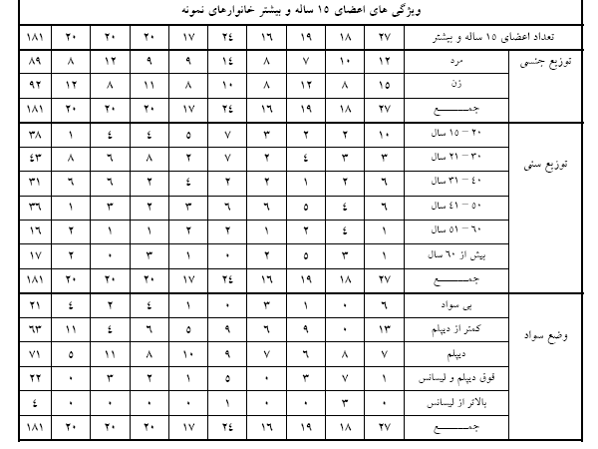

Slide 39
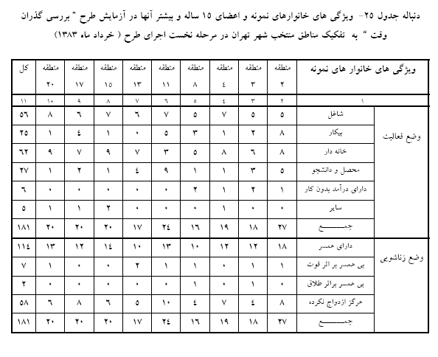

Slide 40
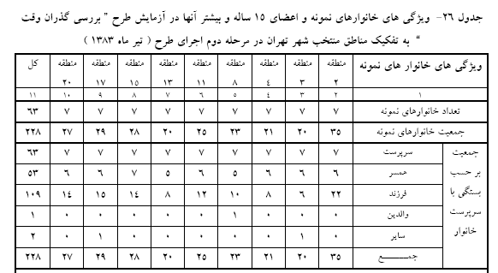

Slide 41
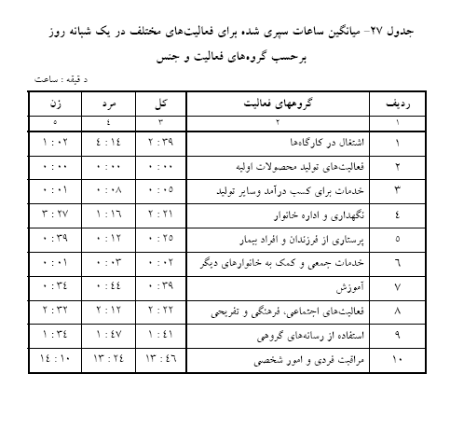

Slide 42
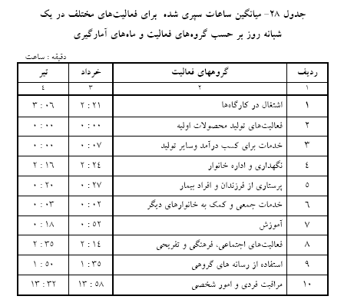

Slide 43
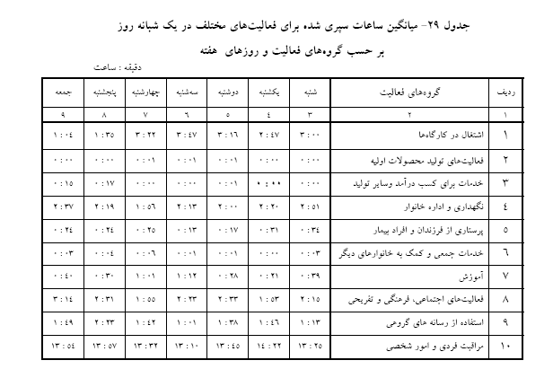

Slide 44
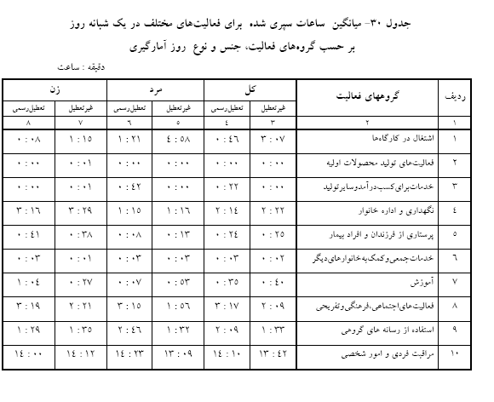

Slide 45
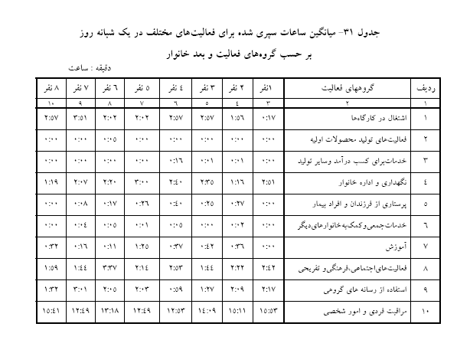

Slide 46
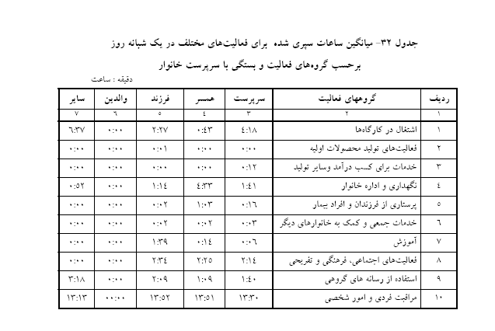

Slide 47
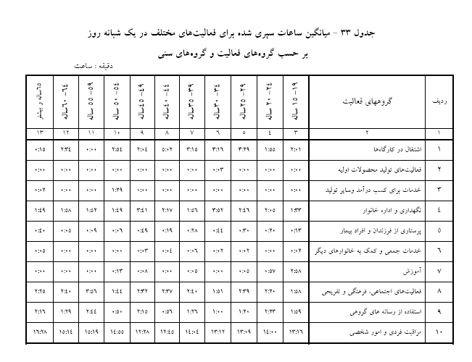

Slide 48
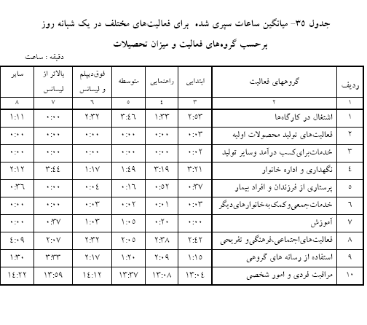

Slide 49
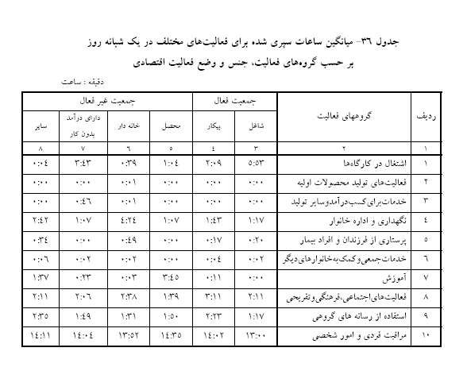

Slide 50
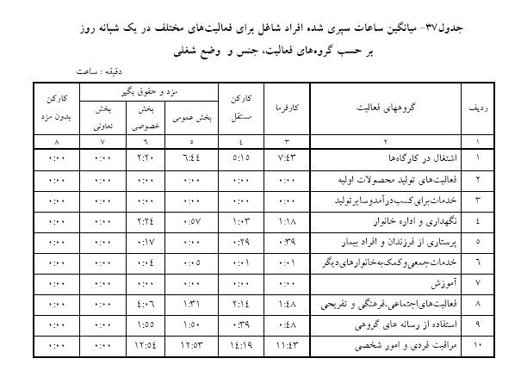

Slide 51
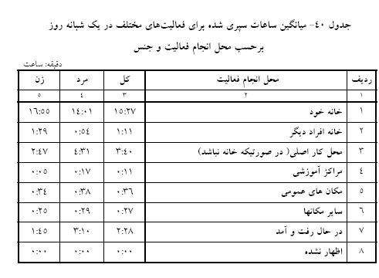

Slide 52
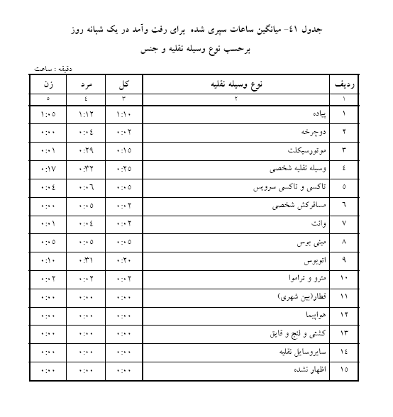

Slide 53
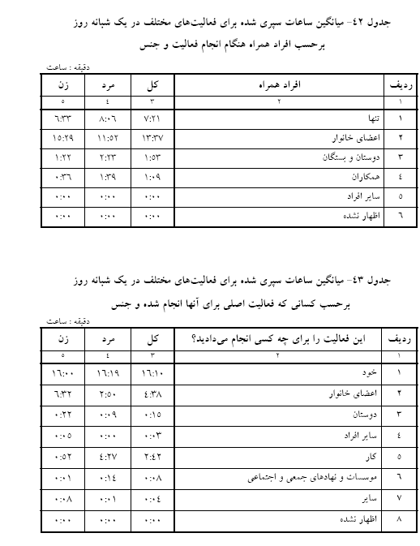

Slide 54
